Slide 1
HIV 101
Positive action foundation Philippines, inc.

Slide 2

History of HIV
1981
First cases appear; GRID; 4 Hs
1982
Acquired Immune Deficiency Syndrome (AIDS) is used to refer to the disease; First AIDS cases reported in Africa
1984
HIV was isolated
1991
AIDS becomes the No. 1 killer in Africa

Slide 3
History of HIV
2010
33.5 M PLHIVs worldwide
90% from low to middle-income countries
7,400 new cases daily (50% >25y/o; ~370 cases < 14y/o the rest 15-24y/o)
Philippines among 7 countries w/ >25% increase of incidence
34 M PLHIVs worldwide
Philippines among 9 countries w/ >25% increase of incidence
2012

Slide 4


2018 Global Estimated HIV Cases
37.5 Million PLHIVs
Sub-Saharan Africa*
22.0 million
[20.5 – 23.6 million]
South & South-East Asia*
4.2 million
[3.5 – 5.3 million]
*Regions with the highest number of actual cases
Sources:

Slide 5
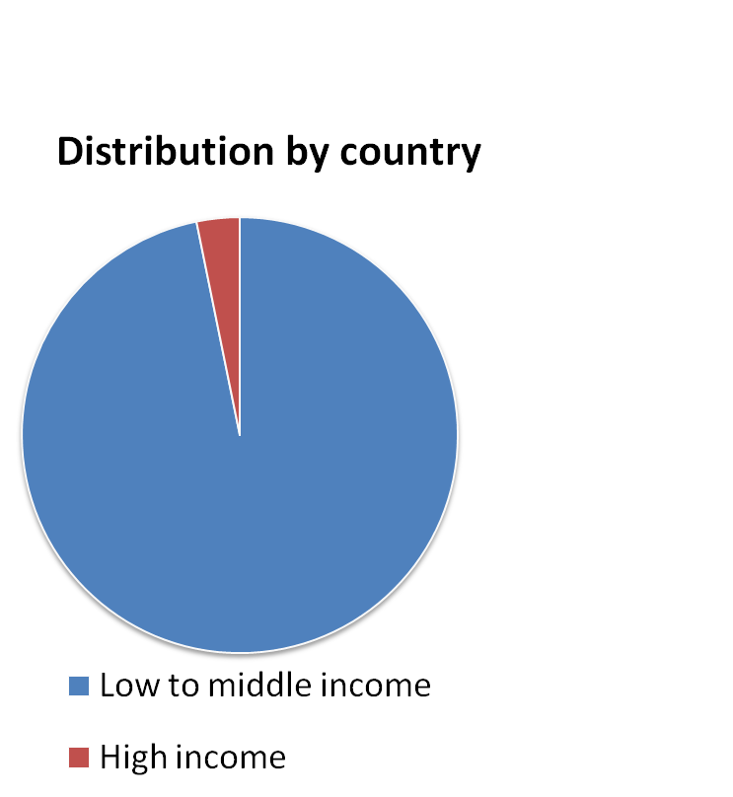
The Most Affected Population Globally
Over 5,200 individuals are infected daily, as of 2018

Slide 6
HIV in the Philippines
1984
First case reported
1992
Establishment of PNAC
1998
Enactment of RA 8504
1999
Adoption of Implementing Rules and Regulations drafted by multi sectoral members of the PNAC

Slide 7
Let’s talk about the numbers
1984 to 1993
475 cases (Low and Slow)
1994 to 2003
1, 526 cases ( Hidden and Growing)
2004 to 2013
14, 515 cases (Fast and Furious)
3 decades of HIV = 16, 516 cases

Slide 8
Let’s talk about the numbers
2014
2017
6, 011 cases
11, 103 cases
2015
2018
Jan - Jul
7,829 cases
11, 429 cases
2016
9, 264 cases

Slide 9
What are we facing now?
42 new cases
daily
170%
Increase
63, 278 total
cases
Prevalance

Slide 10

Isang uri ng mikrobyo na pag nakapasok sa katawan ng isang tao may kakayahang, atakehin at sirain ang natural na depensa nito.
R
Ano ang HIV?
H.I.V.
Human Immunodeficiency Virus
Philippine National AIDS Council & Take The Test Campaign, Inc.

Slide 11
1
R
Sa usapin ng HIV dapat
tandaan ang mga numerong
3
5
2
4
Philippine National AIDS Council & Take The Test Campaign, Inc.

Slide 12
R
1
Ano ang kaugnayan ng HIV sa mga sumusunod?:
Sexually Transmissible Infections
Tuberculosis
Pregnancy
Philippine National AIDS Council & Take The Test Campaign, Inc.

Slide 13
◊ Parehas ng paraan ng pagkakahawa
R
1
Ano ang
kaugnayan ng STI sa HIV?
◊ Parehas ng paraan ng pag-iwas
◊ Pinatataas ng STI ang tsansang mahawa sa HIV
◊ Ito ang ating entry point sa pagbibigay impormasyon
Philippine National AIDS Council & Take The Test Campaign, Inc.

Slide 14
◊ Ang TB ay senyales ng isang mahinang natural na depensa
R
1
Ano ang kaugnayan ng TB sa HIV?
◊ Ang mahinang resistensya ng isang tao
ay naglalagay sa kanya sa posibilidad
na magkaroon ng Opportunistic Infection
◊ Ang TB sa Pilipinas ay pinakamadalas na OI sa isang taong may HIV
Philippine National AIDS Council & Take The Test Campaign, Inc.

Slide 15
◊ Ang pagbubuntis ay isang patunay na nakipagtalik ang babae nang walang proteksyon
R
1
Ano ang kaugnayan ng Pagbubuntis sa HIV?
◊ Ang pagbubuntis ay maaaring makapagpasa ng HIV mula sa ina patungo sa kanyang anak
Philippine National AIDS Council & Take The Test Campaign, Inc.

Slide 16
R
2
Ano ang dalawang yugto ng HIV?
Philippine National AIDS Council & Take The Test Campaign, Inc.

Slide 17
Ito ay ang matagumpay na pagpasok ng mikrobyo ng HIV sa katawan ng tao
R
2
HIV INFECTION
Philippine National AIDS Council & Take The Test Campaign, Inc.

Slide 18
Ito ang kondisyon na produkto ng pagkasira ng natural na depensa dulot ng HIV
R
2
AIDS
CONDITION
Acquired Immuno Deficiency Syndrome
Philippine National AIDS Council & Take The Test Campaign, Inc.

Slide 19
R
3
Ano ang tatlong pamamaraan ng pagkahawa ng HIV?
Philippine National AIDS Council & Take The Test Campaign, Inc.

Slide 20
Pakikipagtalik nang walang proteksyon
R
3
Paano Naihahawa ang HIV?
Pagtanggap ng kontaminadong dugo
Mula sa inang positibo ng HIV patungo sa kanyang anak
Philippine National AIDS Council & Take The Test Campaign, Inc.

Slide 21
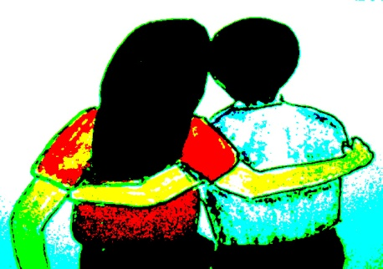
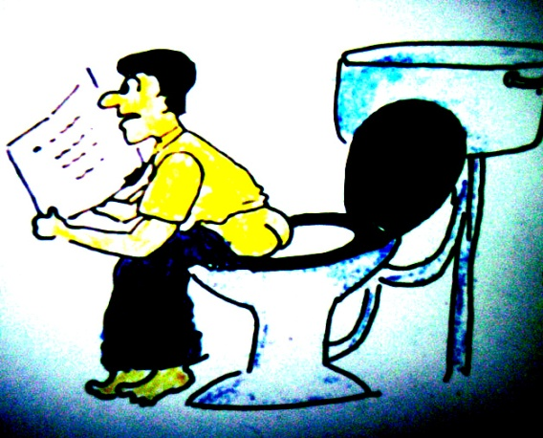
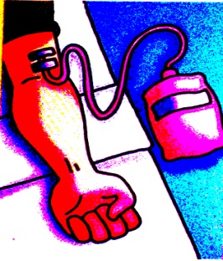
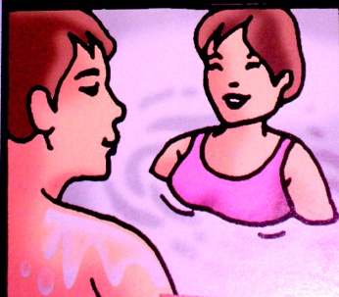
Hindi ka mahahawa sa HIV sa pamamagitan ng:
Casual contacts
sharing food and utensils
shaking hands
hugging or kissing
coughing, sneezing
using public phone
visiting a hospital)
Feces, urine, saliva, sweat, tears
Insect bites
Sharing toilets
Swimming with PLHIVs
Donating blood
Sources of illustrations: DOH, Remedios AIDS Foundation, UNICEF; UNODC
Philippine National AIDS Council & Take The Test Campaign, Inc.

Slide 22
Apat na Likido
R
4
Prinsipyo ng Pagkakahawa
Kundisyon para mabuhay ang HIV
Philippine National AIDS Council & Take The Test Campaign, Inc.

Slide 23
Dugo
R
4
Ano-anong mga likido sa katawan ang mataas ang konsentrasyon ng HIV?
Tamod
Hima
Gatas ng Ina
Philippine National AIDS Council & Take The Test Campaign, Inc.

Slide 24
Exit of the virus from a PLHIV
R
4
Ano-ano ang 4 na prinsipyo sa matagumpay na pagkakahawa ng HIV?
Survival of the virus in the fluid
Sufficiency of the virus
Entry to the bloodstream of a new host
Philippine National AIDS Council & Take The Test Campaign, Inc.

Slide 25
No sudden change in Temperature
R
4
Ano-anong mga kondisyon ang magpapanatili sa buhay ng mikrobyo ng HIV?
Enviroment should have normal Acidity
Environment should be Moist
No exposure to Air
Philippine National AIDS Council & Take The Test Campaign, Inc.

Slide 26
5
Prevention
How can I protect myself from HIV?
Philippine National AIDS Council & Take The Test Campaign, Inc.

Slide 27
Abstinence (Ayoko muna)
R
5
Paano maiiwasan ang HIV?
Be Mutually Faithful (Basta Ikaw at ako lang)
Consistent & Correct Condom Use
(Condom gamitin ng palagian at tama)
Do not use drugs & alcohol
(Droga at alkohol ay iwasan)
Education & early detection of HIV
(Edukasyon at maagang pag-alam)
Philippine National AIDS Council & Take The Test Campaign, Inc.

Slide 28
Personal Risk Assessment
Have you or any of your partners engaged in unprotected sex (any form of sex includes oral, vaginal or anal) with a person with multiple sex partners?
Did you or your Did you or any of your partner(s) undergo any blood transfusion or organ transplant from an unreliable source?
partner(s) contract sexually transmitted infection in the last five (5) years?
Have you or any of your partners injected drugs with shared needles and/or syringes?
Source: PNAC
Philippine National AIDS Council & Take The Test Campaign, Inc.

Slide 29

♦Thank you ♦
Philippine National AIDS Council & Take The Test Campaign, Inc.

